Slide 1

Monadnock Broadband Group
FirstNet Overview
January 28, 2019
Owen Smith- AT&T Regional Vice President
©2018 AT&T Intellectual Property.FirstNet, First Responder Network Authority, and FirstNet logo are registered trademarks and service marks of FirstNet, an independent authority within the U.S. Department of Commerce. All other marks are the property of their respective owners.

Slide 2
AT&T New Hampshire
190 employees, 326 retirees living in NH
Nashua business office
76 retail location
$8 million generated in state & local taxes from AT&T operations (2017)
More than $72 million spent on goods & services purchased from NH based suppliers
AT&T invests $20-$25 million every year in our network (wireless & wireline)
We’ve added 120 plus sites since 2009
AT&T began overlaying the network with LTE 700 MHz in 2013
DirectTV- Largest pay TV provider in the world
Uplink facilities- New Hampton/ Littleton

Slide 3



BUILT FOR PUBLIC SAFETY. INSPIRED BY PUBLIC.
First Responder Network Authority
Over 100 years in emergency response solutions.
March 2010
FCC follows the 911 Commission’s recommendation to create a nationwide
public safety network.
February 2012
The FirstNet Authority was authorized to develop and oversee the dedicated nationwide network for first responders.
March 2017
AT&T awarded contract to provide the capabilities for FirstNet to be built.
December 2017
All U.S. states & territories opt in.
Today
We are developing the tools that advance public safety with you.

Slide 4
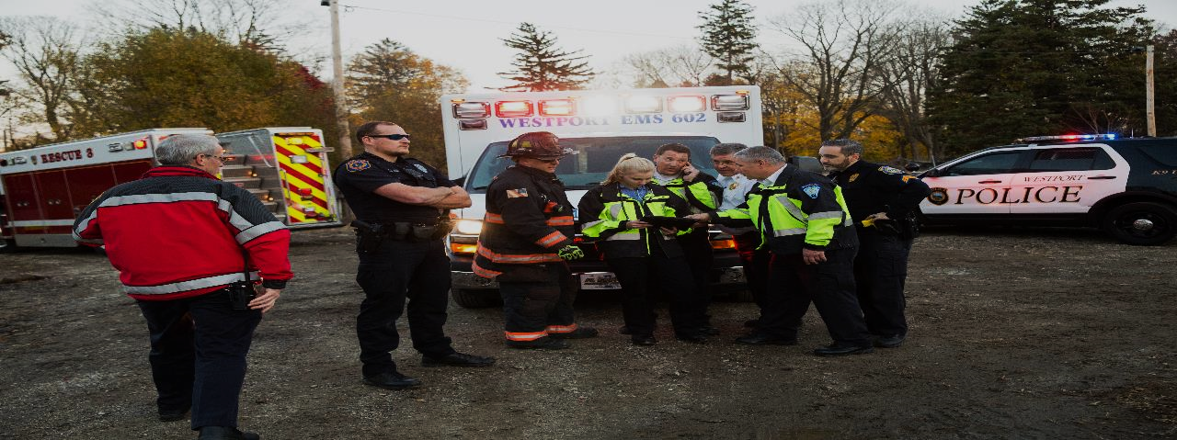


Innovative Public-Private Partnership
Customer
experience
20MHz Spectrum
$180B in total
AT&T Network Assets
Technology
&
Innovation
FirstNet
AT&T
Program
management
Public
safety
Secured
Network
Telecom
Expertise
Purpose Built: Creating an infrastructure dedicated to public safety
© 2017 AT&T intellectual property. All rights reserved. AT&T and Globe Logo are registered trademarks and service marks of AT&T Intellectual property. FirstNet, First Responder Network Authority and FirstNet logo are registered trademarks and service marks of FirstNet, an independent authority within the U.S. Department of Commerce. All other marks are the property of their respective owners.
Notes:
First public-private partnership in the industry.
Using the backbone, expertise of AT&T to build out a dedicated Public Safety broadband network
FirstNet
Program Management
20MHz Spectrum & $6.5B Funding
Customer Experience Innovation
Public Safety Expertise & Relationships
AT&T
Technology Innovation & $40B investment
$180B Infrastructure & Services
Security (Cyber, Application & Network)
Telecommunications Expertise

Slide 6
PLAY VIDEO
FIRST PRIORITY™
Ensuring Quality of Service for first responders is our commitment.
QUALITY OF SERVICE
FIRST PRIORITY™*
First responders maintain access to critical communications resources at all times to ensure connectivity and capacity.
First responders receive access to resources first, ahead of others. You’re always on, without throttling of text or data.
In times of crisis, first responders within the network get first access to necessary resources through the automatic preemption capabilities of the network.
*Priority is available to extended primary users through a monthly fee.

Slide 7

CONNECTED IN A CRISIS
INCIDENT
FIRST RESPONSE
SUPPORT RESPONSE
INCIDENT RESOLVED
PRIMARY
EXTENDED PRIMARY
Elevated priority status and improved communication.
First responders arrive at the scene and begin to resolve issue.
Support responders assist first
responders at the scene.
Responders leave scene and public resumes normal operations.

Slide 8
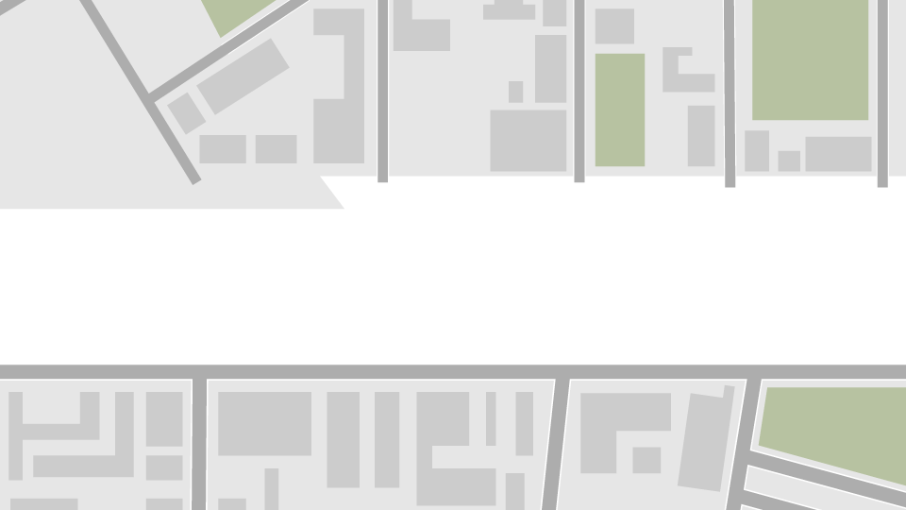
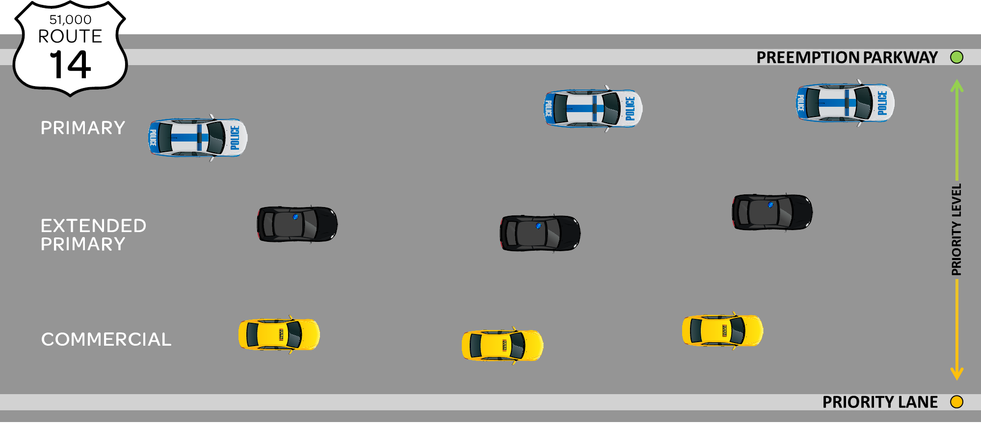
NORMAL OPERATIONS
QPP PARKWAY
AT&T Proprietary (Restricted) Only for use by authorized individuals or any above-designated team(s) within the AT&T companies and not for general distribution. © 2016 AT&T Intellectual Property. All rights reserved. AT&T, the AT&T logo and all other AT&T marks contained herein are trademarks of AT&T Intellectual Property and/or AT&T affiliated companies. The information contained herein is not an offer, nor commitment, and not for use outside AT&T except under written agreement.
24
Notes:
Even during normal operation, First responder's traffic is assigned priority access and preemption abilities on the Band 14 network. However, when there is no congestion on the network traffic flows unimpeded and spare capacity is used to accommodate secondary commercial users.

Slide 9



CRISIS OCCURS
QPP PARKWAY
COMMERCIAL TRAFFIC
AT&T Proprietary (Restricted) Only for use by authorized individuals or any above-designated team(s) within the AT&T companies and not for general distribution. © 2016 AT&T Intellectual Property. All rights reserved. AT&T, the AT&T logo and all other AT&T marks contained herein are trademarks of AT&T Intellectual Property and/or AT&T affiliated companies. The information contained herein is not an offer, nor commitment, and not for use outside AT&T except under written agreement.
25
Notes:
When more users enter network, the network relies on the high priority access and pre-emption features assigned to First responders so that their traffic continues to experience no impact in latency and throughput.

Slide 10
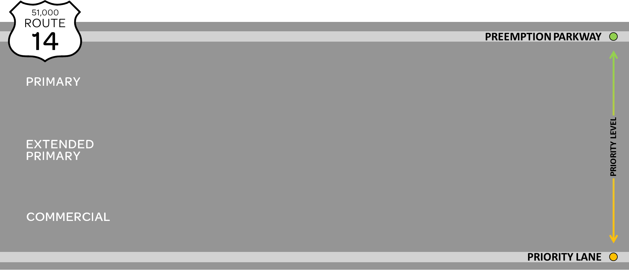




CRISIS WORSENS
QPP PARKWAY
AT&T Proprietary (Restricted) Only for use by authorized individuals or any above-designated team(s) within the AT&T companies and not for general distribution. © 2016 AT&T Intellectual Property. All rights reserved. AT&T, the AT&T logo and all other AT&T marks contained herein are trademarks of AT&T Intellectual Property and/or AT&T affiliated companies. The information contained herein is not an offer, nor commitment, and not for use outside AT&T except under written agreement.
26
Notes:
As the network begins to experience even more congestion, the network makes the decision based on the high priority access and preemption assignments, to delay access and remove if necessary lower priority traffic from the network so that First responders continue to have access to their applications, and priority treatment while on the network.

Slide 11
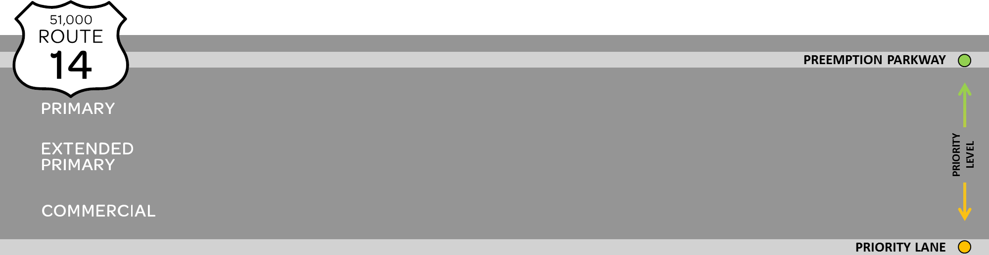




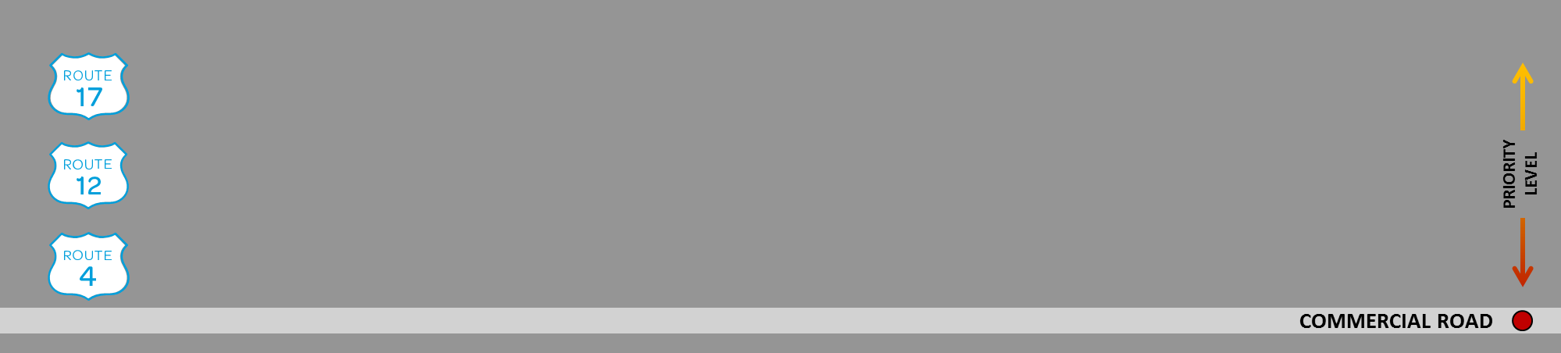
CRISIS WORSENS
QPP PARKWAY
27
AT&T Proprietary (Restricted) Only for use by authorized individuals or any above-designated team(s) within the AT&T companies and not for general distribution.
© 2016 AT&T Intellectual Property. All rights reserved. AT&T, the AT&T logo and all other AT&T marks contained herein are trademarks of AT&T Intellectual Property and/or AT&T affiliated companies. The information contained herein is not an offer, nor commitment, and not for use outside AT&T except under written agreement.
Notes:
If the congestion peaks, at some point only First responders traffic would traverse band 14, and traffic with lower network assignments would be directed to commercial bands or delayed access to the network so that First responders continue to have unimpeded access to the network. The network could pre-empt lower priority traffic to ensure First responders can access the network.
The priority and pre-emption assignments to First responders provide their devices experience the network performance, throughput and latency needed to access mission critical applications.

Slide 12
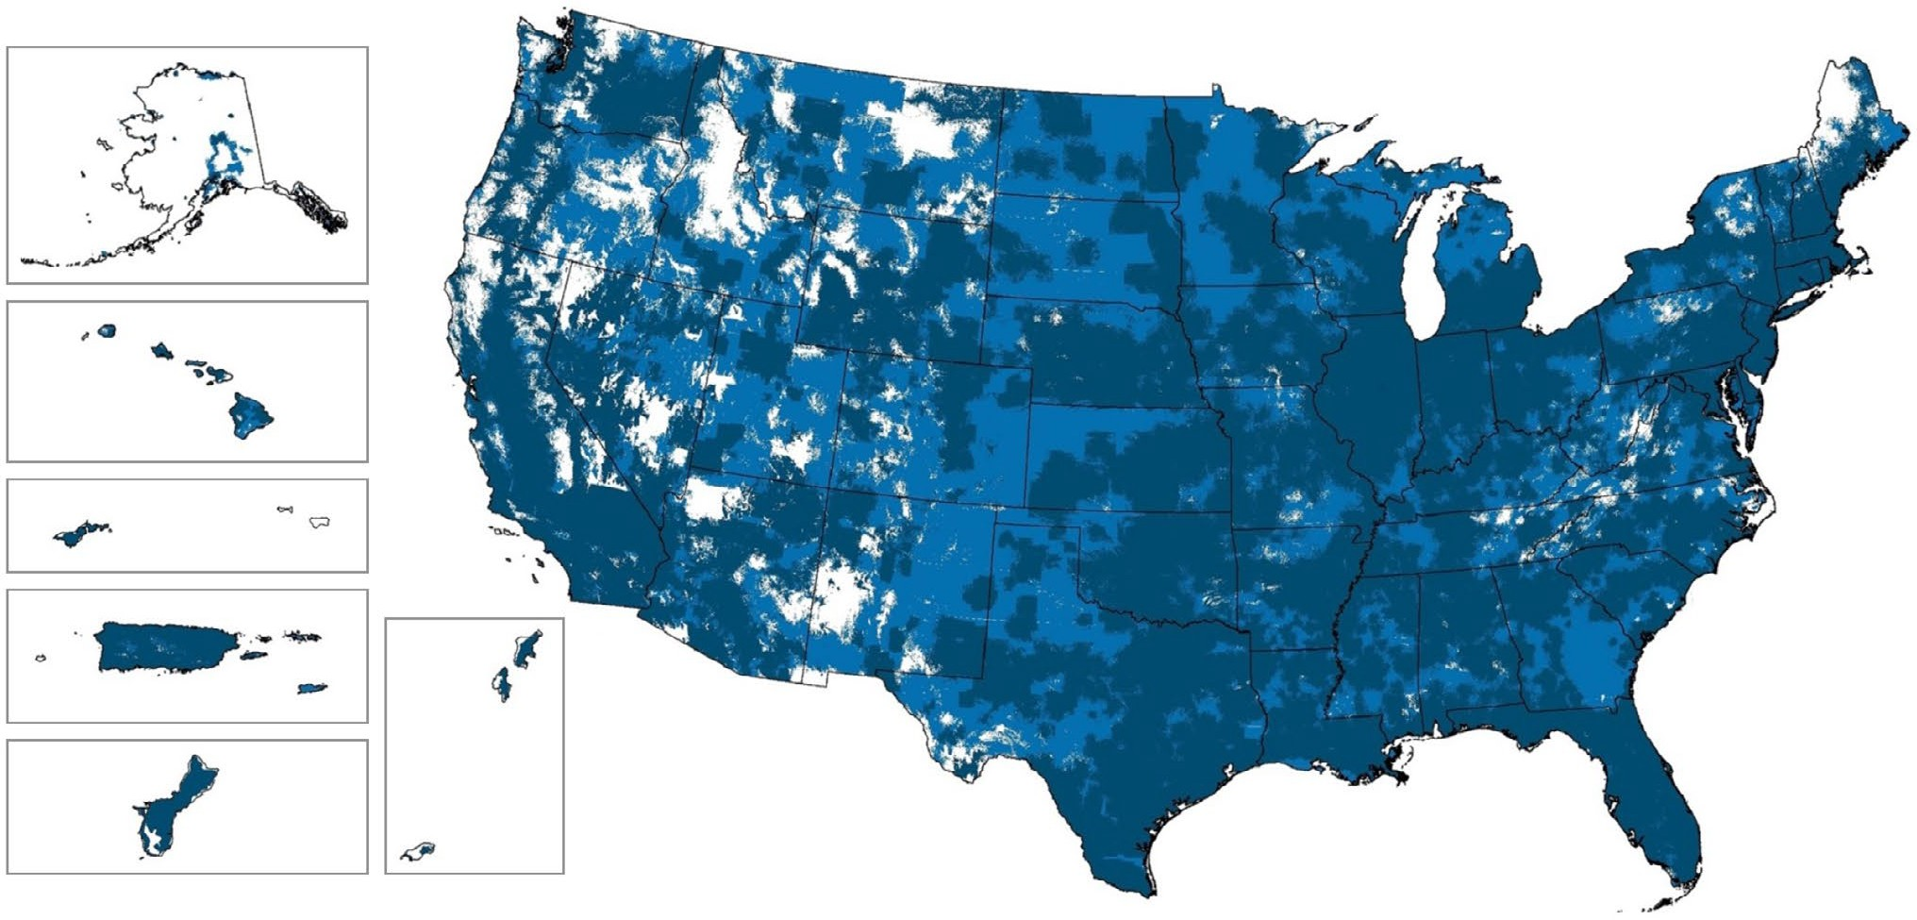
COVERAGE EXPANSION
Coverage extends to 2.74 million square miles. Users can access the network from 99 percent of the country.
LTE with Priority Preemption
LTE Band 14 with Priority Preemption
FirstNet Network Outdoor LTE Coverage at Full Operational Capability by 2022.

Slide 13
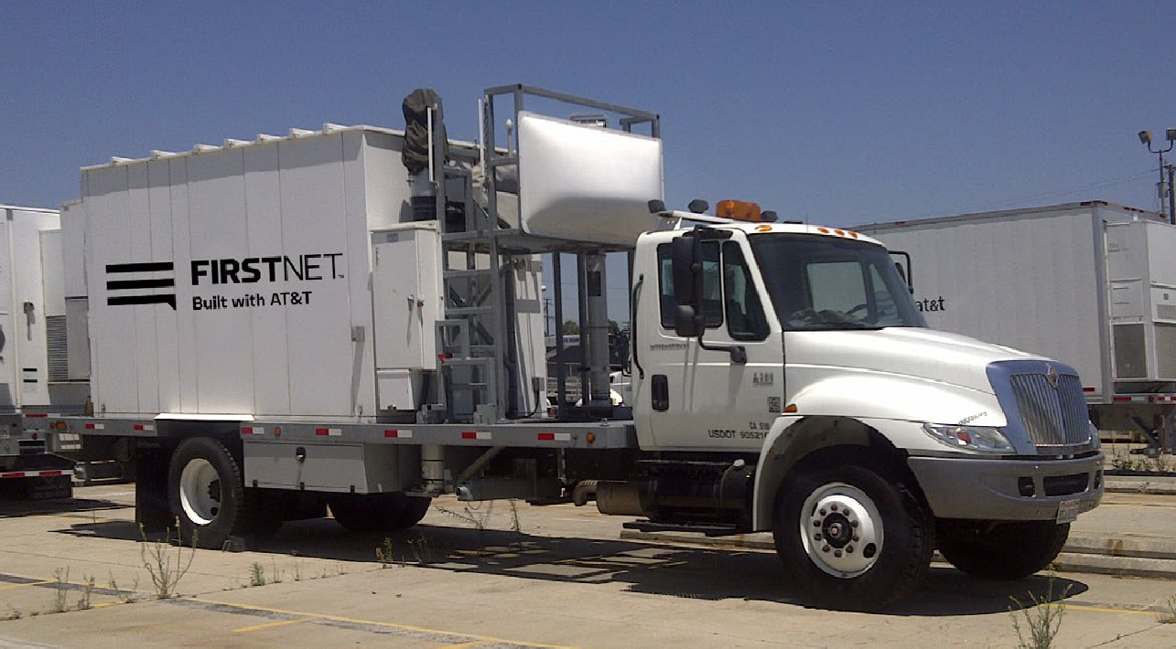
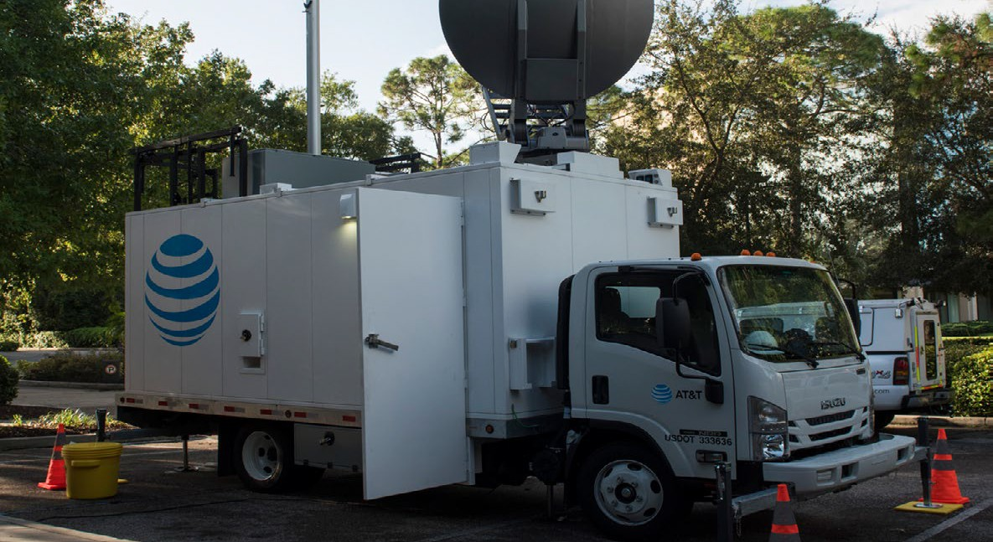
DEPLOYABLE PROGRAM
Dedicated deployables
Dedicated nationwide fleet including deployables
like Band 14 Satellite Cell on Light Trucks
AT&T deployables
Access to commercial Cell on Wheels and Cell on Light Trucks
+
Benefit: Helps ensure business continuity and disaster recovery
Benefit: Augments dedicated resources and redundancies for any situation

Slide 14
QUESTIONS?
www.fitstnet.cgov
www.firstnet.gov www.firstnet.com
Security
Coverage
Devices
Control
Innovation

